Slide 1
Lecture 14
A lot of slides were borrowed from Prof. Alvarado.

Slide 2


Slide 3

Unsorted linked list
Insert new element in front
Easy, O(1), fast
Remove by searching list for highest-priority item
Slow, may have to scan the whole list O(N)

Slide 4

Sorted linked list
Always insert new elements where they go in priority-sorted order
Slow, O(n)
Remove from front
Fast, O(1)

Slide 5
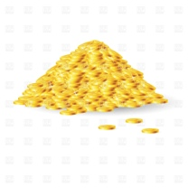
Can we combine them?
Fast add AND fast remove/peek
Yes! New data structure: heap.

Slide 6
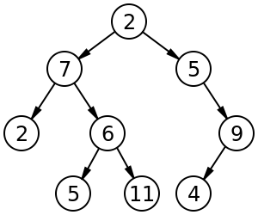
Complete Binary tree
Binary tree is a tree data structure in which each node has at most two children: left and right.
In a complete binary tree every level, except possibly the last, is completely filled, and all nodes in the last level are as far left as possible.
Height of tree –The height of a tree is the number of edges on the longest downward path between the root and a leaf.

Slide 7
Heaps
Heaps are ONE kind of binary tree
They have a few special restrictions, in addition to the usual binary tree ADT:
Binary tree must be complete
Ordering of data must obey heap property
Min-heap version: a parent’s data is always ≤ its children’s data
Max-heap version: a parent’s data is always ≥ its children’s data

Slide 8
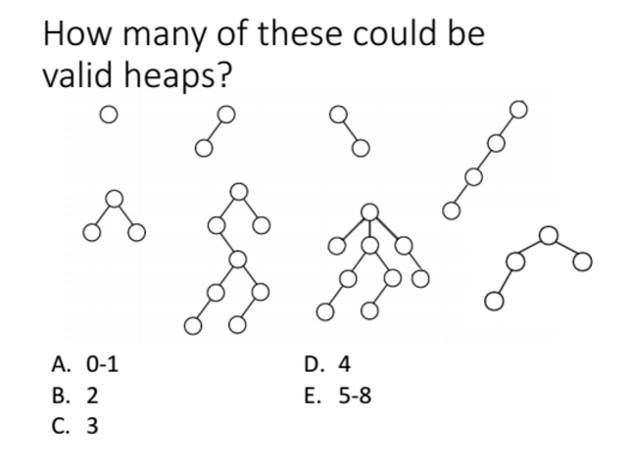
D

Slide 9
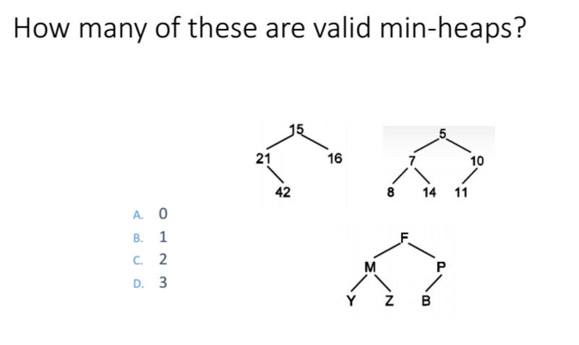
B

Slide 10
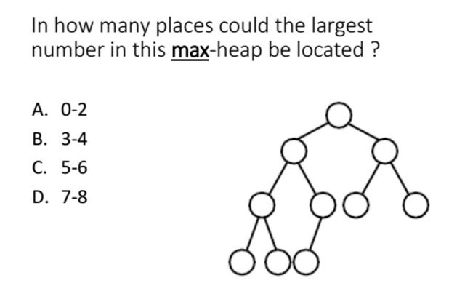
A

Slide 11
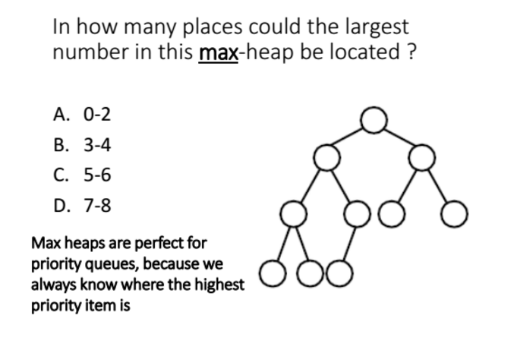

Slide 12
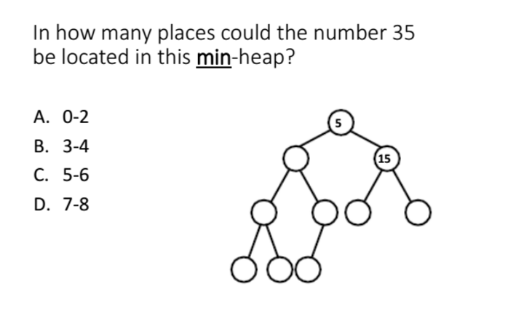
D

Slide 13
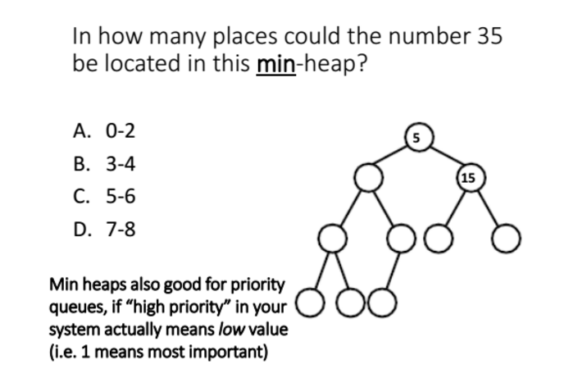

Slide 14
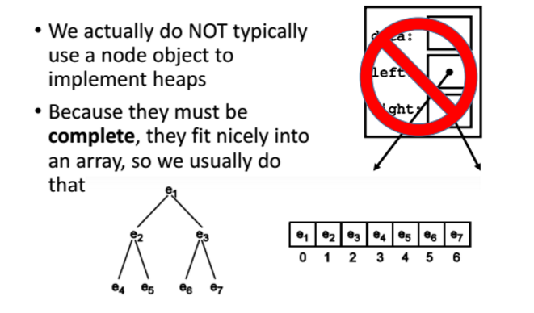
Heap implementation

Slide 15
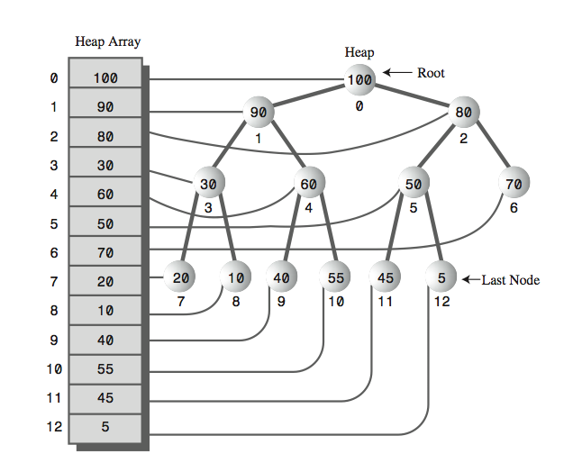

Slide 16
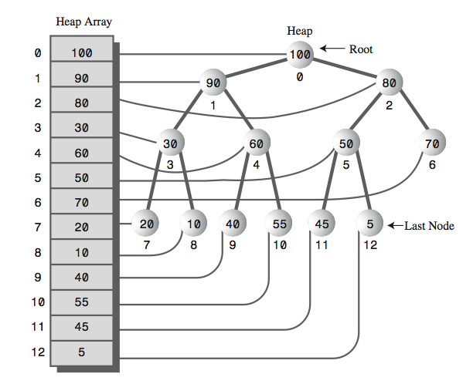
Parent?
For a node in array index i: Parent is at array index:
A. i – 2
B. i / 2
C. (i – 1)/2
D. 2i

Slide 17
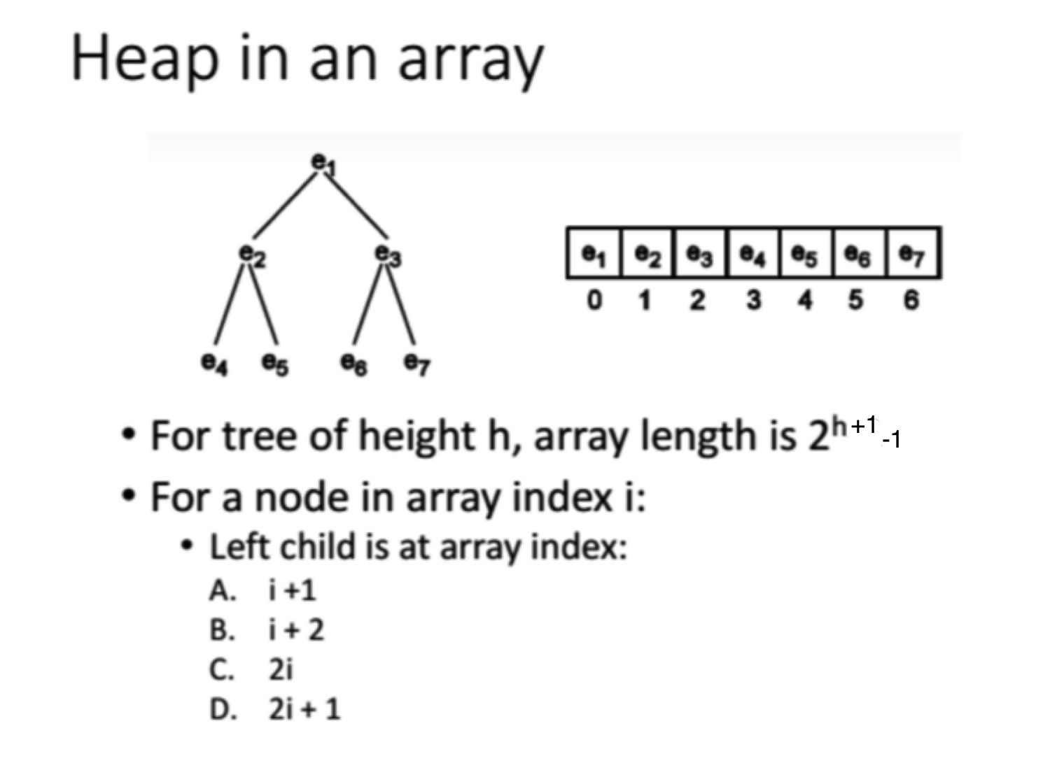
D

Slide 18
Right child?
For a node in array index i: Right child is at array index:
A. i +1
B. i + 2
C. 2i
D. 2i + 2

Slide 19
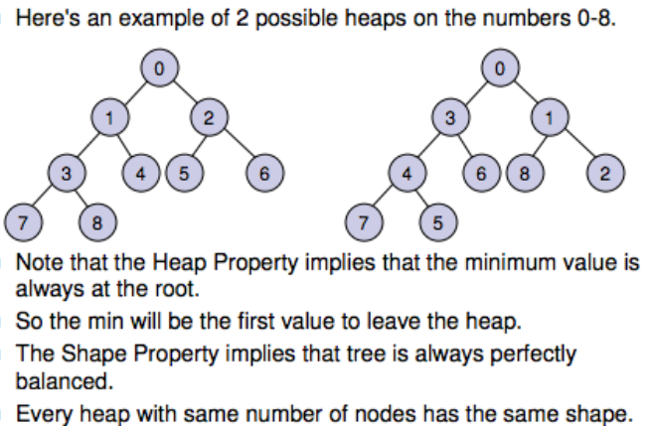
Heap concept

Slide 20
Is it a max-heap?
Arr = (10, 5, 3, 6, 2, 1)
A: Yes
B: No
Notes:
Draw the solution on a board; create an heap from an array

Slide 21
Heap insert and Delete

Slide 22
Insert
Arr = (10, 6, 3, 5, 2, 1)
Insert 4. Where should it go??
Need to minimize time for each operation.
What place is the fastest to add?
To the end of the array: O(1).
Preserves completeness of the tree.
Notes:
You can reuse the heap from the prev. question. Draw the example and use students to help you.

Slide 23
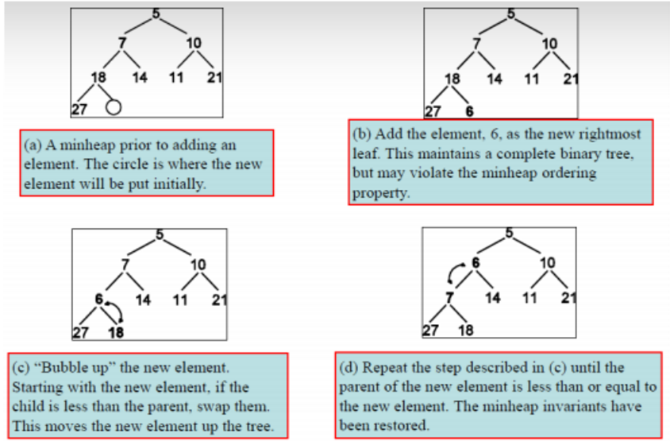
Insert
Notes:
You could go over another example from this slides. Just talk it over if time permits. I usually play by ear.

Slide 24
How long does it take to insert?
A: O(1)
B: O(log n)
C: O(n)
D: O(n log n)
E: O(n^2)
Hint: what is the height of a tree?
Notes:
Sometimes I keep the hint, sometimes I do not. The second common answer is D. So I spend time explaining the difference.

Slide 25
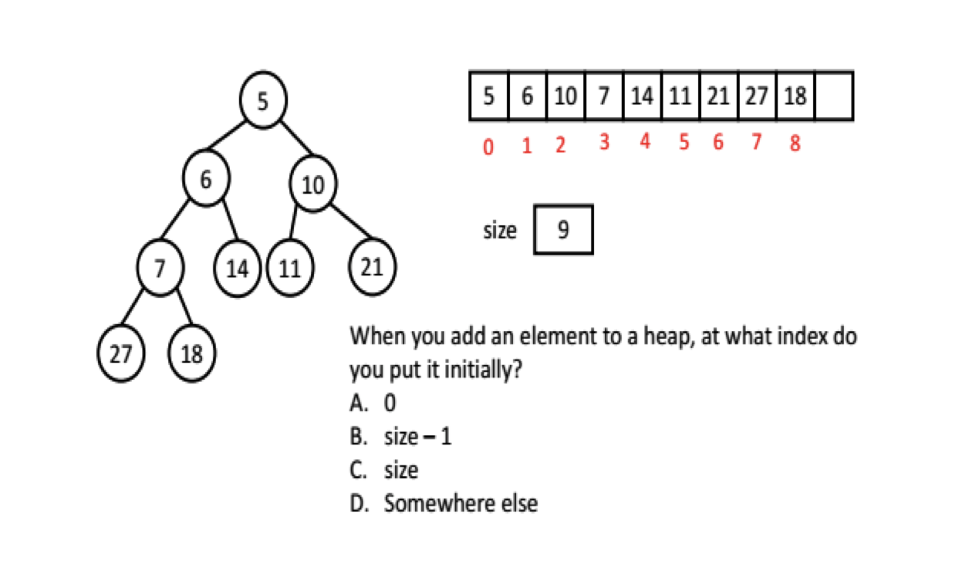
Heap insert
C
Notes:
The indices are off, forget to change them each time.

Slide 26
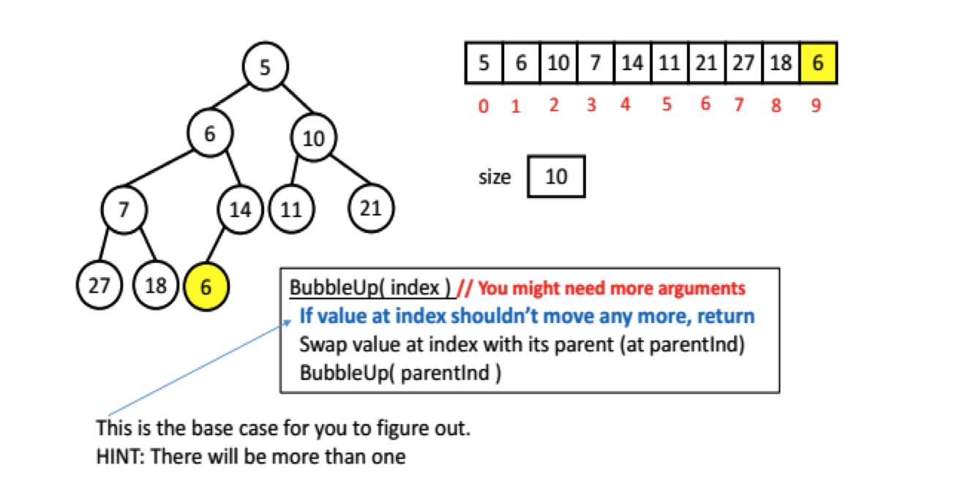
Bubble up
To insert an element, you will need a helper method called BubbleUp. I suggest recursion, and here’s a very rough recursive algorithm, though it’s up to you to figure out the base case. You can talk to others in the class about this.

Slide 27
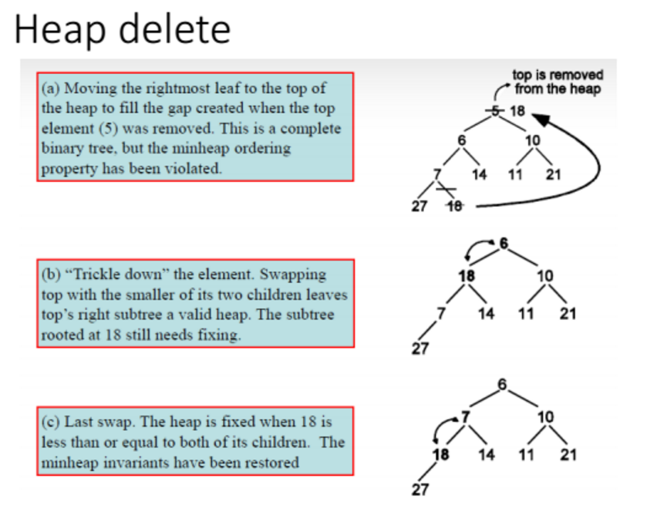
Notes:
I usually run the example on the board, so that students can see the steps.

Slide 28
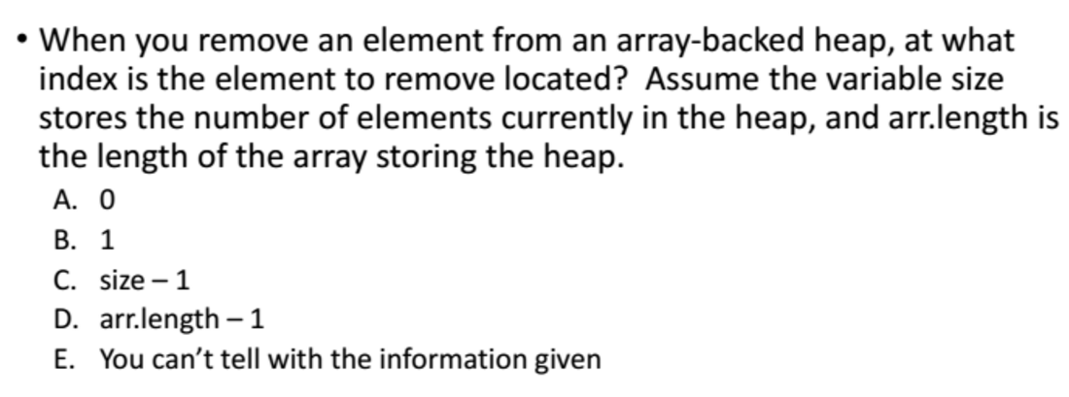
Heap remove (smallest/largest)
A

Slide 29
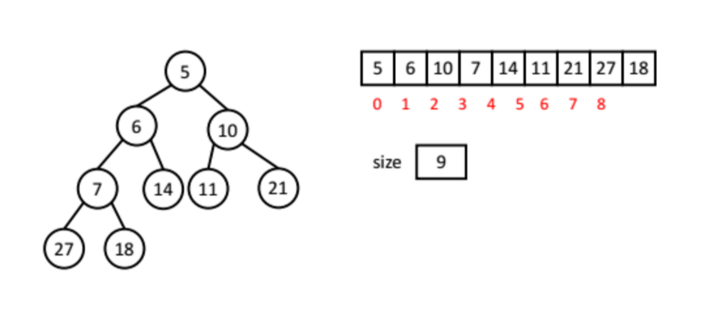
Heap remove (smallest/largest)

Slide 30
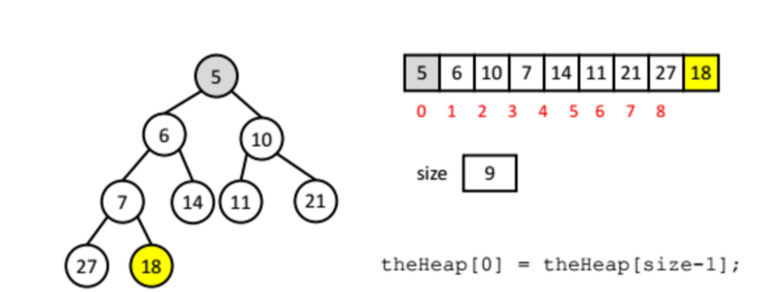
Heap remove (smallest/largest)

Slide 31
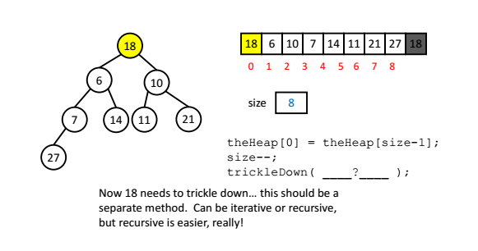
Heap remove (smallest/largest)

Slide 32
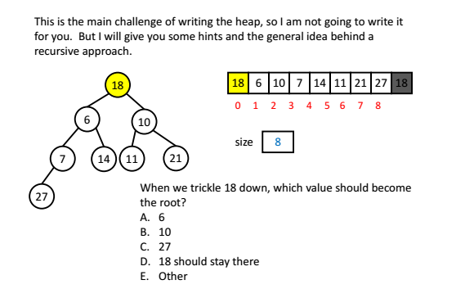
Trickle down (min heap)
A

Slide 33
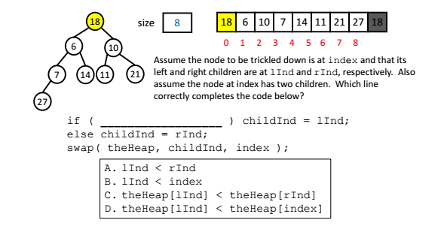
Trickle down
C

Slide 34
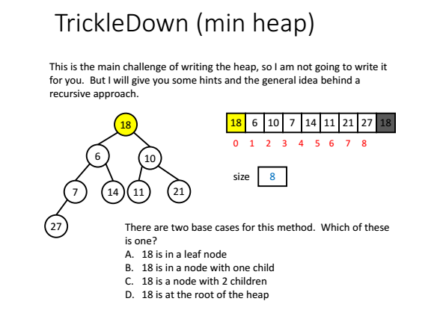
A

Slide 35
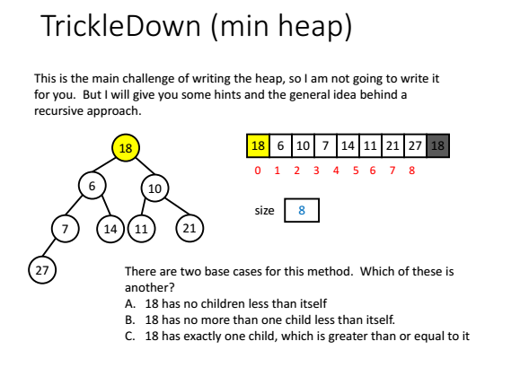
A

Slide 36
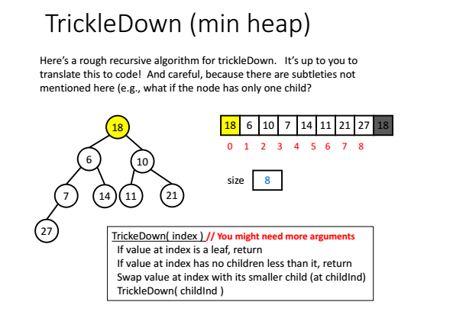

Slide 37
Finding an arbitrary node
Heaps offer fast access to the largest/smallest node in the heap.
What if the element that the user wants to find is NOT the largest/smallest element?
A: Since it is a binary tree we can find it fast O(log n)
B: The binary tree does not help here and we need to search through the entire array O(n).

Slide 38
Finding an arbitrary node
If the element is not the largest/smallest, then it could be anywhere in the heap.
This contrasts with binary search trees (more later).
Hence, to find an element within a heap, we must search through the entire heap.

Slide 39
Removing an arbitrary node n (max heap)
Let assume we found the index of node n.
Then we can swap the last node in the heap (right most child of last level) with n.
Then we just trickleDown that node and we are done. Right?

Slide 40
Wrong!
The above procedure worked for removeLargest() because we always started from the top (root) of the heap.
By trickling down from the top, we guarantee that every sub-tree (starting from the very top) is a valid heap.
When removing an arbitrary node, the trickleDown process will “fix” the sub-tree rooted at n, but not necessarily the whole tree.

Slide 41
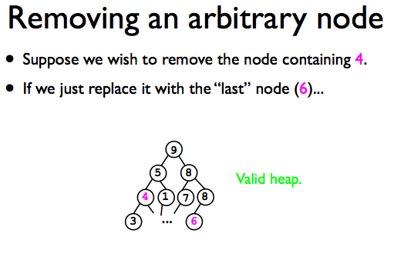

Slide 42
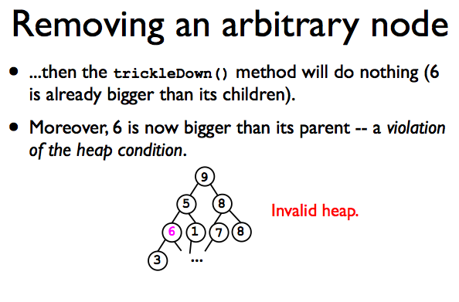

Slide 43
Removing an arbitrary node
void remove (..)
{
find the node n,
if ( n > heap[lastIndex])
swap n with heap[lastIndex]
--?--
else
swap n with heap[lastIndex]
--?--
}
Notes:
I usually ask students to help me out here.

Slide 44
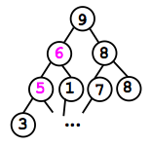
Removing an arbitrary node
void remove (..)
{
find the node n,
if ( n > heap[lastIndex])
swap n with heap[lastIndex]
trickleDown
else
swap n with heap[lastIndex]
BubbleUp
}

Slide 45
Time cost
Find ?
Remove
Find ?
Swap ?
Either trickle node down or bubble up ?
Notes:
Also just ask students to answer these questions. Without iclikcer

Slide 46
Time cost
Find O(n)
Search through all nodes.
Remove
Find O(n)
Swap O(1)
Either trickle node down or bubble up O(log n)
Total is O(n)+O(1)+O(log n)=O(n).

Slide 47
Heap sort

Slide 48
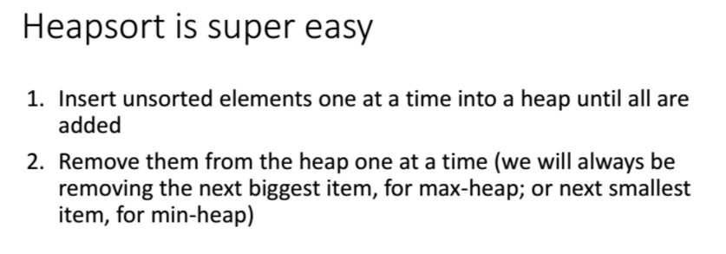
Heapsort
Unlike mergesort, we don’t need a separate array for our workspace.
We can do it all in place in one array (the same array we were given as input)
Notes:
I usually give them example on the board. Start with array of random numbers. Then create a heap. Then ask Iclicker question (create one on the board), how long does it make to create a heap from a give array.

Slide 49
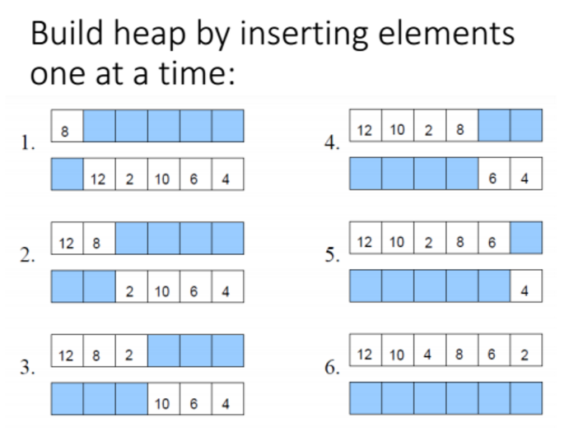
Building a heap

Slide 50
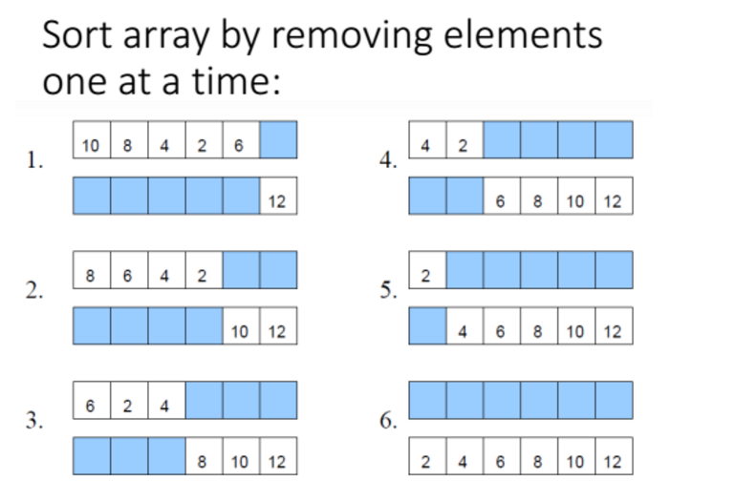

Slide 51
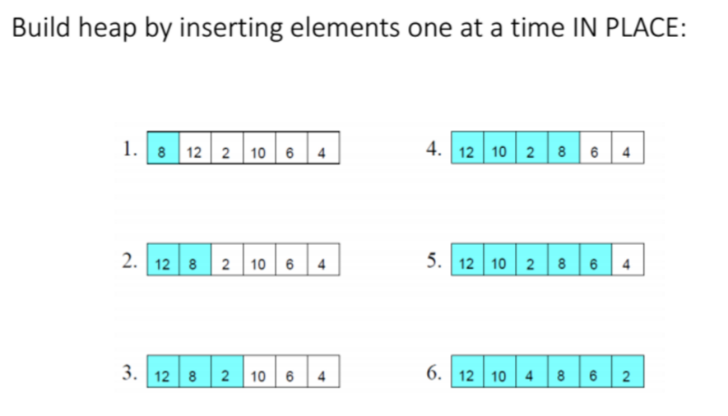

Slide 52
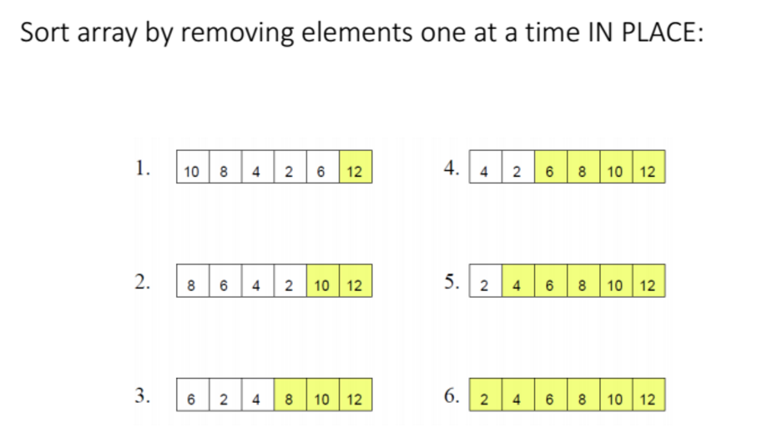

Slide 53
General heaps
Notes:
I go over these slides if times permits (or next lecture). Since their homework usually is about d-ary heaps, I feel it is worth knowing when and why we need them. If you do not have time to cover it, is ok. No more than 5-6 minutes here. Most likely you will not have time for this one.

Slide 54
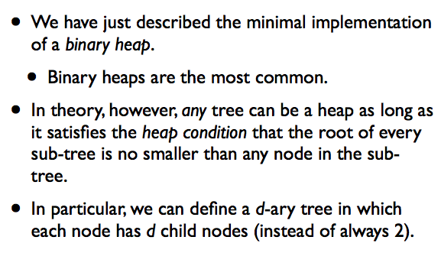
General heaps

Slide 55
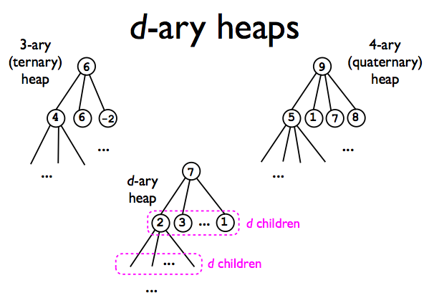

Slide 56
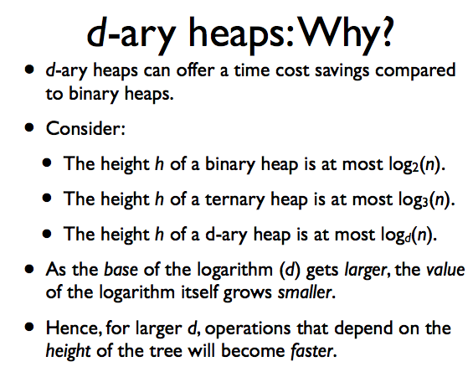

Slide 57
What operation benefits from d-ary heap?
A: None.
B: BubbleUp
C: TrickleDown
D: Both

Slide 58
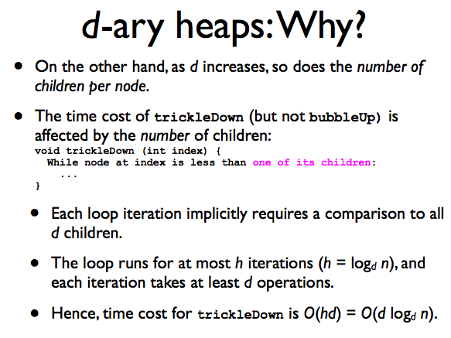

Slide 59
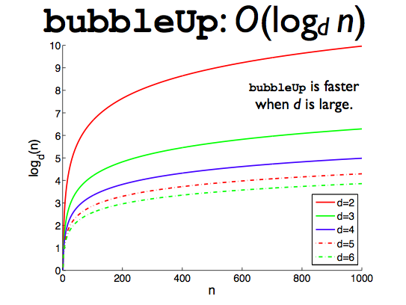

Slide 60
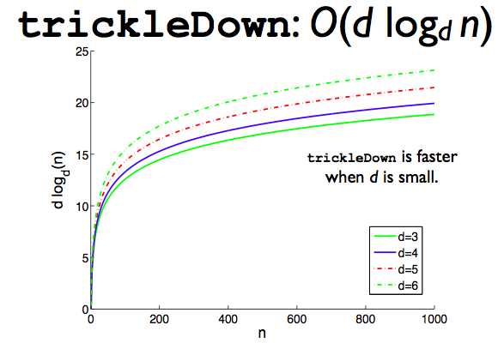

Slide 61
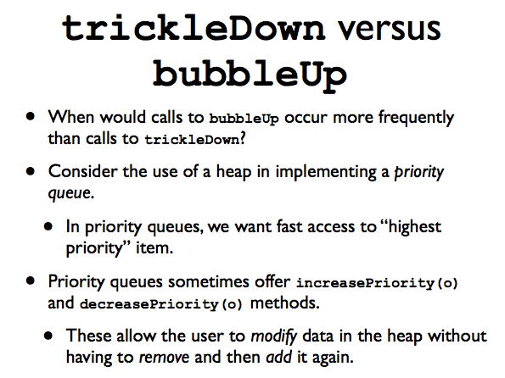

Slide 62
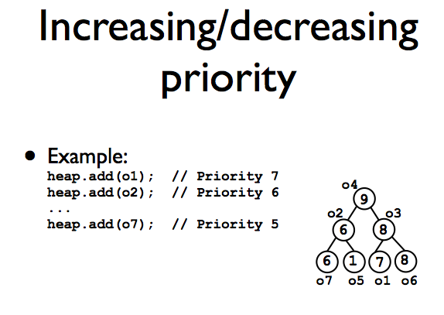

Slide 63
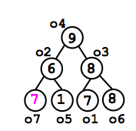
Are we in trouble??
A: Yes, the heap is ruined ;(
B: No, just BubbleUp!

Slide 64
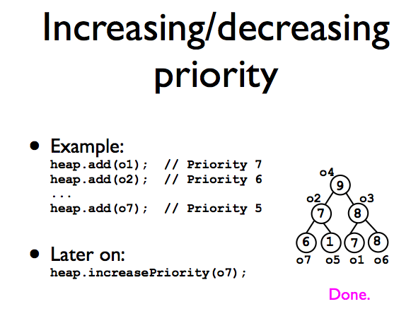

Slide 65
